Slide 1



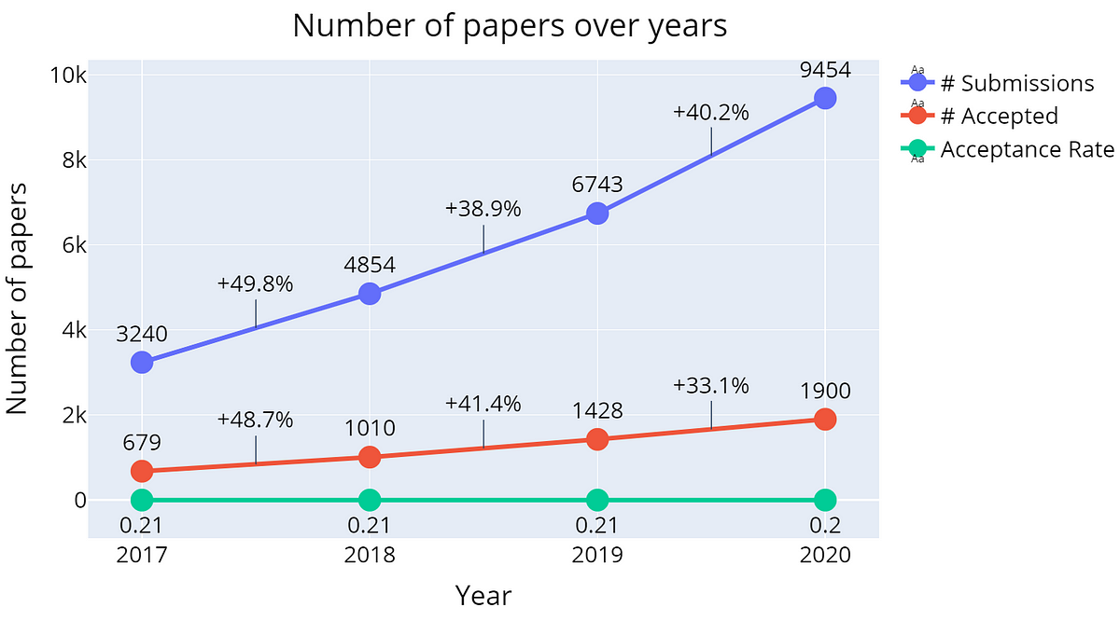




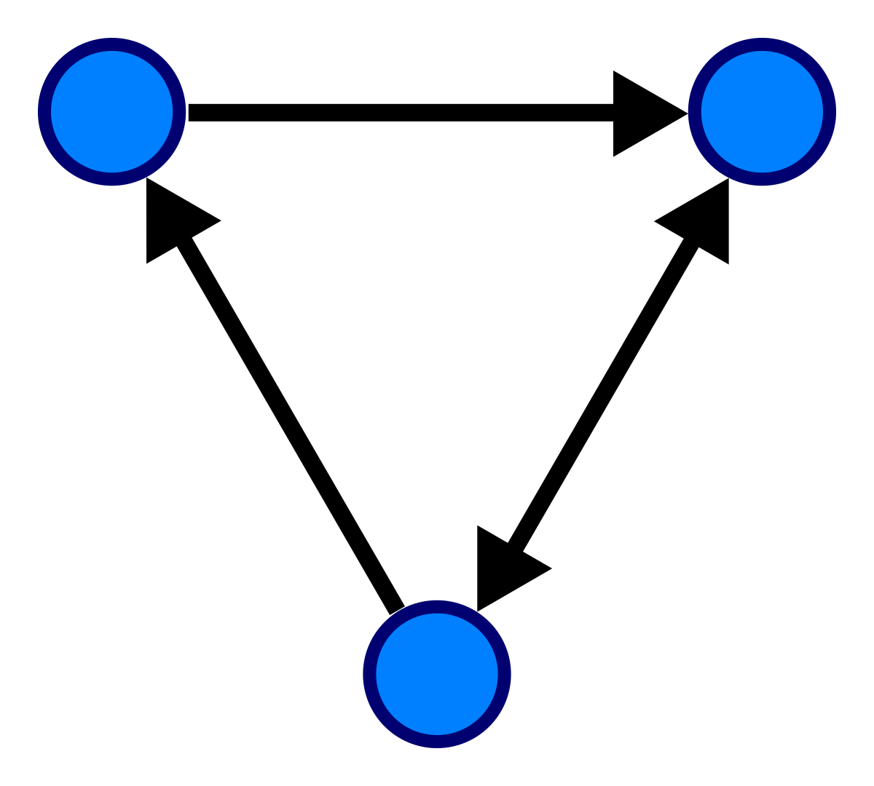
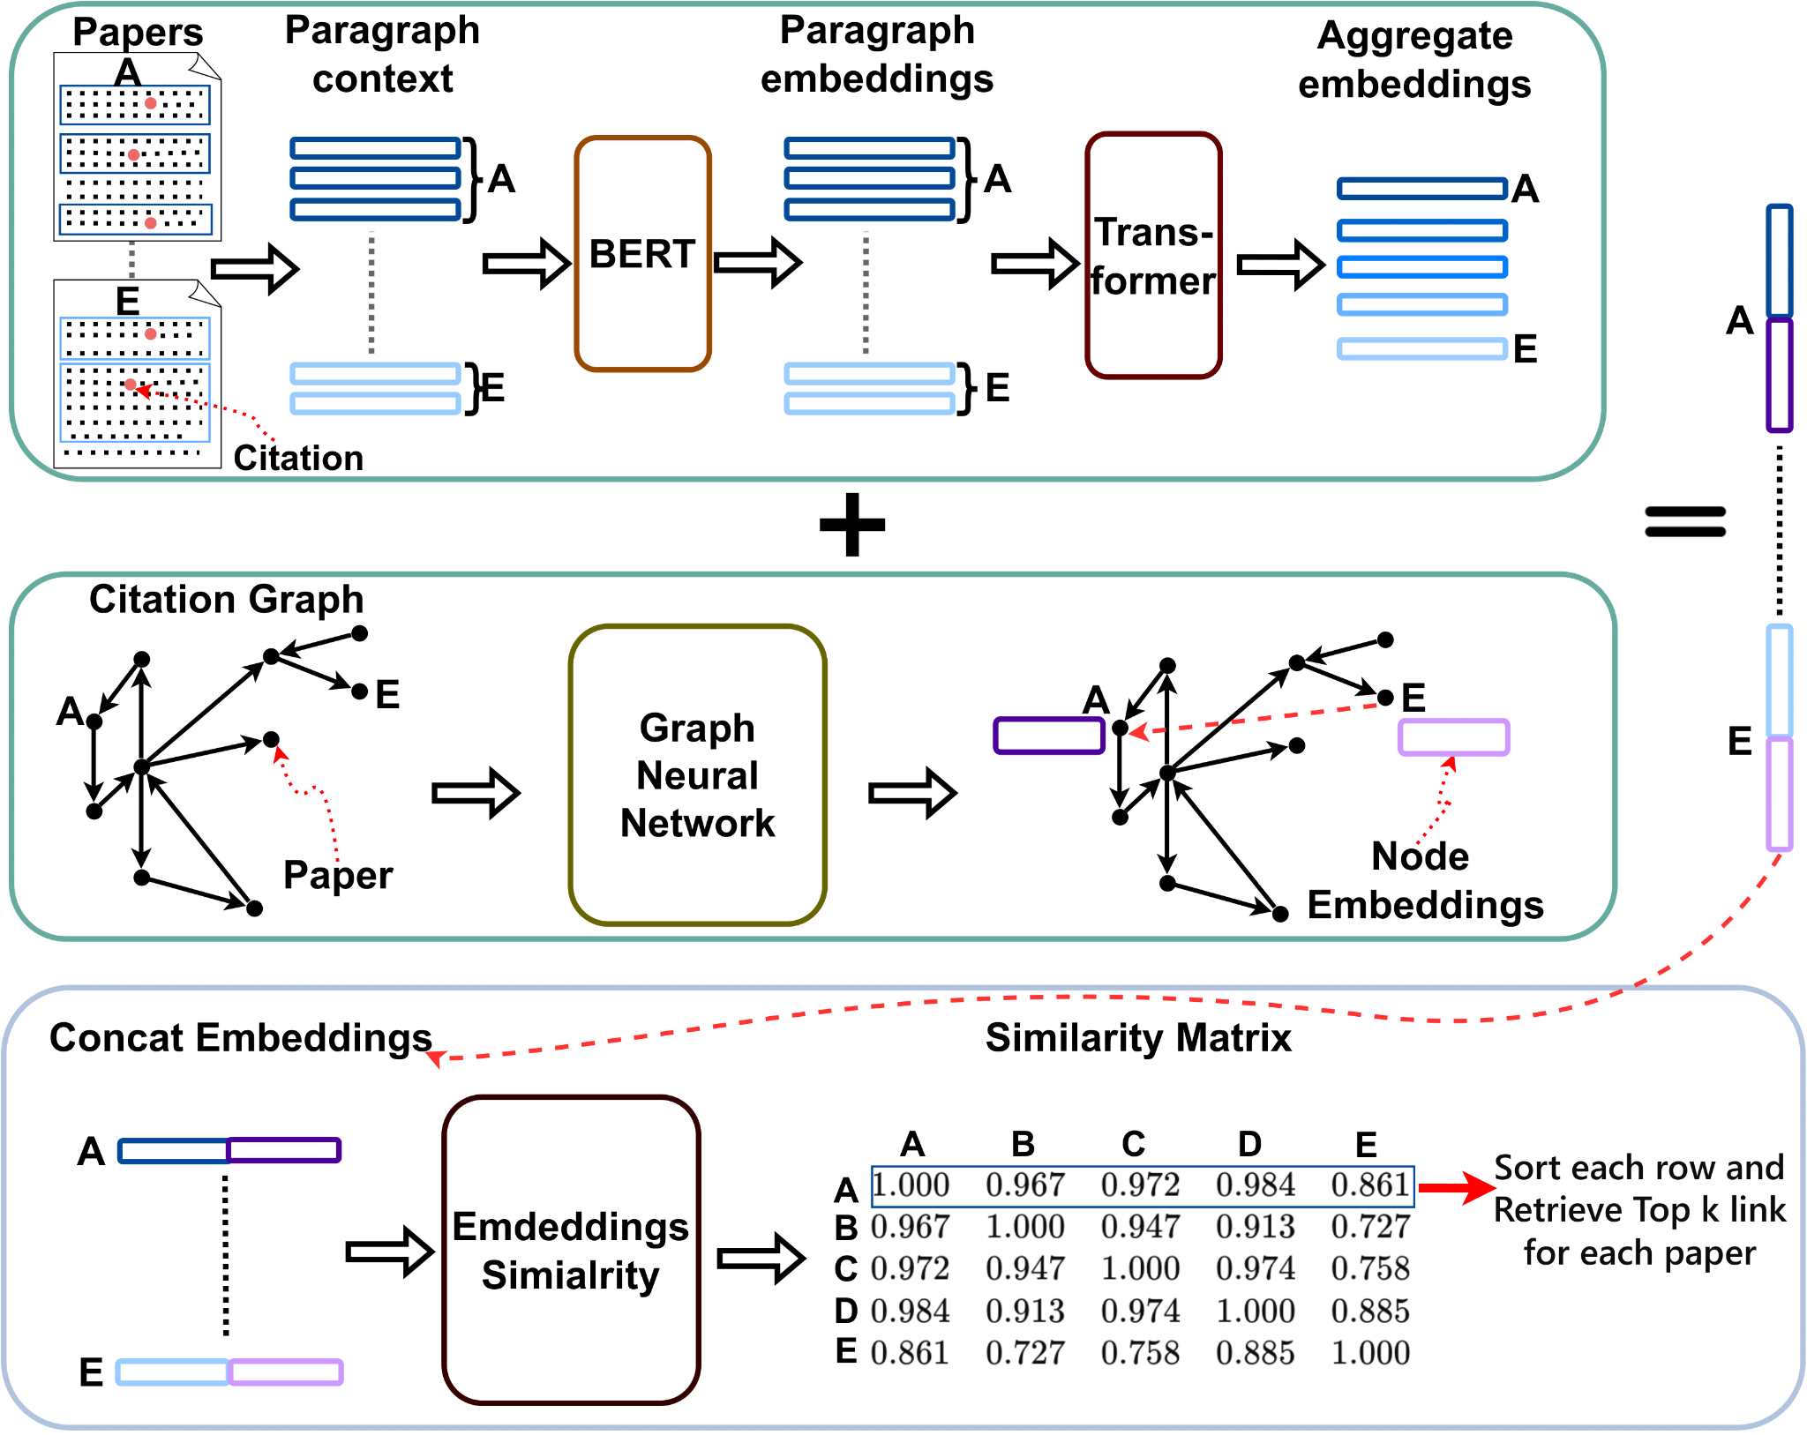
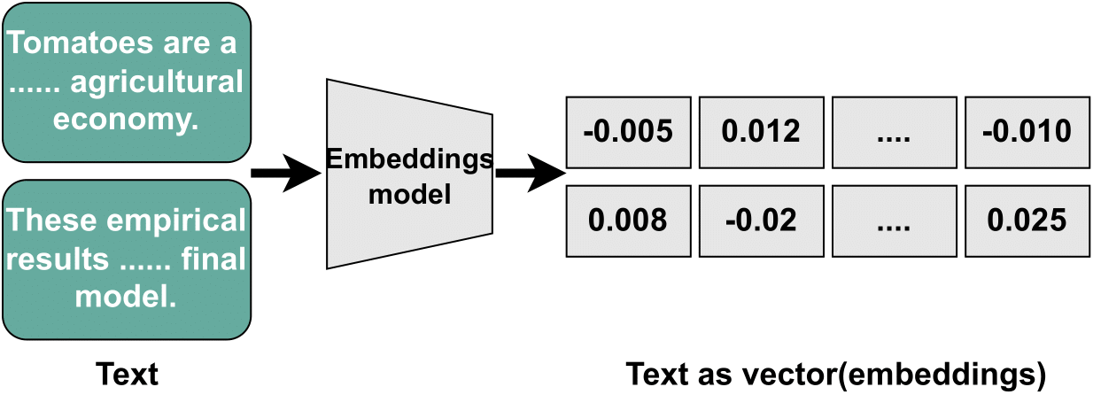
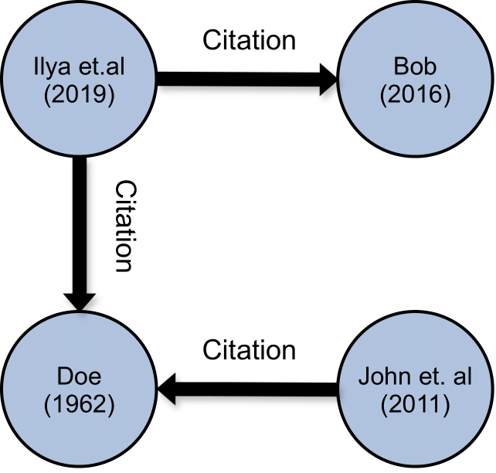
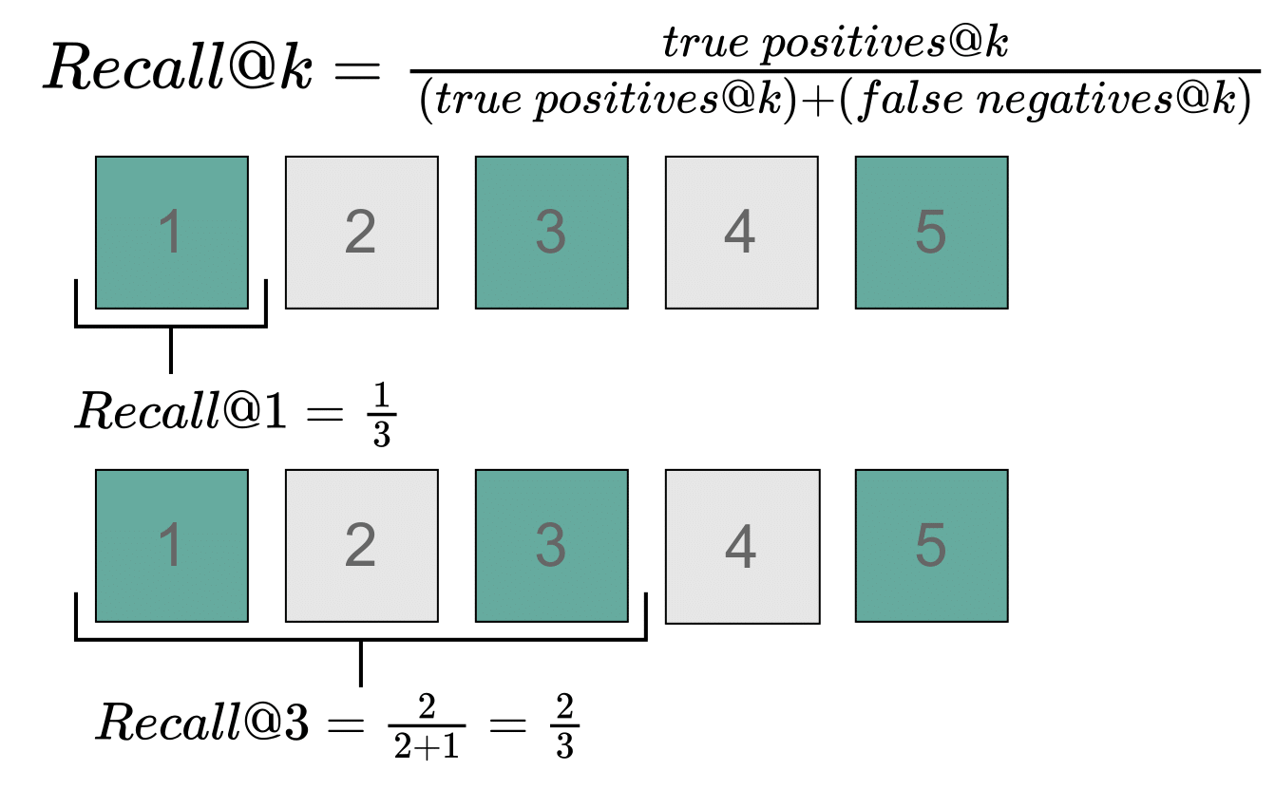
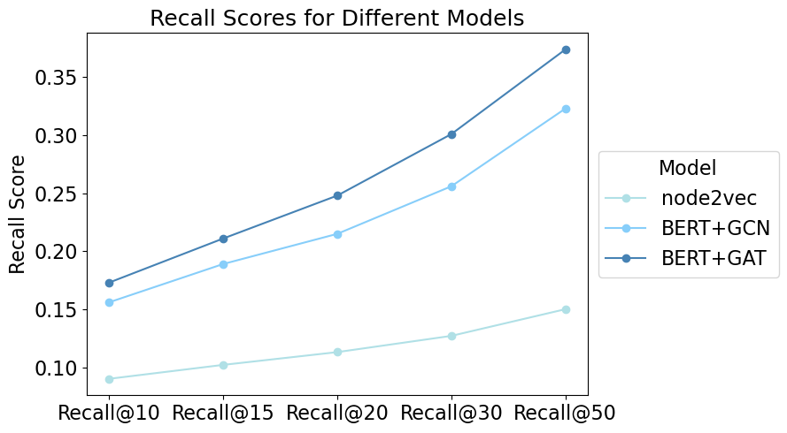
Research Paper Recommendations
Team Members: Sharath Giri, Judy Fang, Jerry Jiang, Jacky Jiang, James Murphy, & Andres Villada
Mentors: Joao Pedro Mattos, Arko Barman
Motivation
Model Exploration
Data Overview
Potential Models
Keyword Search
Strength: Finding relevant data with few keywords
Limitation: Terms are too broad and limiting for researcher exploration
Source Paper Metadata
Source Citation Text
Cited Paper Title
Target Paper Metadata
Research Paper Similarity
Strength: Compares entire papers
Limitation: Papers contain many subjects of interest. Difficult to seek information on singular subject
Fulltext PeerRead
(AI Peer Reviews)
Papers Cited: 3,693
Publish Years: 2007-2017
Citations: 16,669
Fig 1: Published papers ahead of annual NeurIPS conference
Exponential increase in scientific literature
Increasing difficulty in finding relevant literature
More efficient recommendation system needed
Objective
Implement a graph-based paper recommendation system based on contextual citation
ArXivCS
(CS Research Papers)
Papers Cited: 6,236
Publish Years: 1904-2017
Citations: 27,823
Key Concepts
Model Architecture
Embeddings
Lower-dimensional representation of input data
Captures meaningful relationships and patterns, enabling more effective processing.
Graphs
Edges
Connections between nodes
Which paper is citing which paper
Nodes
Unit representation of an entity
Papers are represented as nodes in embedding form
Evaluation Metrics & Results
Conclusion
BERT + GAT architecture produces the best Recall scores followed by BERT + GCN
Key Notes
BERT (Bidirectional Encoder Representations from Transformers)
GCN (Graph Convolutional Network)
GAT (Graph Attention Network)
Recall@K: K is the number of recommendations

